Slide 1

Regional Climate Change Impacts on Water Resources
NOAA-CREST
Reza Khanbilvardi
July 2011

Slide 2
Fresh Water Distribution

Slide 3
Freshwater
Only 2.5% of the planet’s water is freshwater.
And only 1% of that exists on Earth’s surface.
Only 1 part in 10,000 of water is easily accessible for drinking and irrigation.

Slide 4
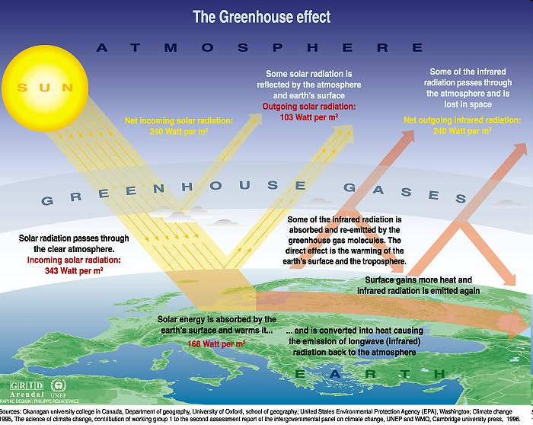

Slide 5
All of the major climate models predict significant temperature increases during the 20th century

Slide 6
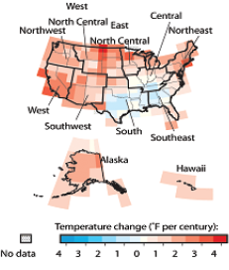
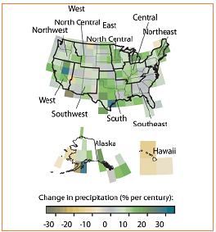
Air Temperature vs. Rainfall/Snowfall
Annual mean temperature anomalies, 1901-2005. Red shades indicate warming over the period, and blue shades indicate cooling over the period.
Annual precipitation trends, 1901-2005. Green shades indicate a trend towards wetter conditions over the period, and brown shades indicate a trend towards dryer conditions.

Slide 7
Melting Ice and Rising Seas
Sea level is already rising worldwide. Mean sea levels have risen approximately 5 to 9 inches (12 to
22 cm) since the 1890s. This is due to the rapid melting of ice and glaciers.
Several major models (the colored lines) project declines in sea ice coverage during the 21st century.

Slide 8
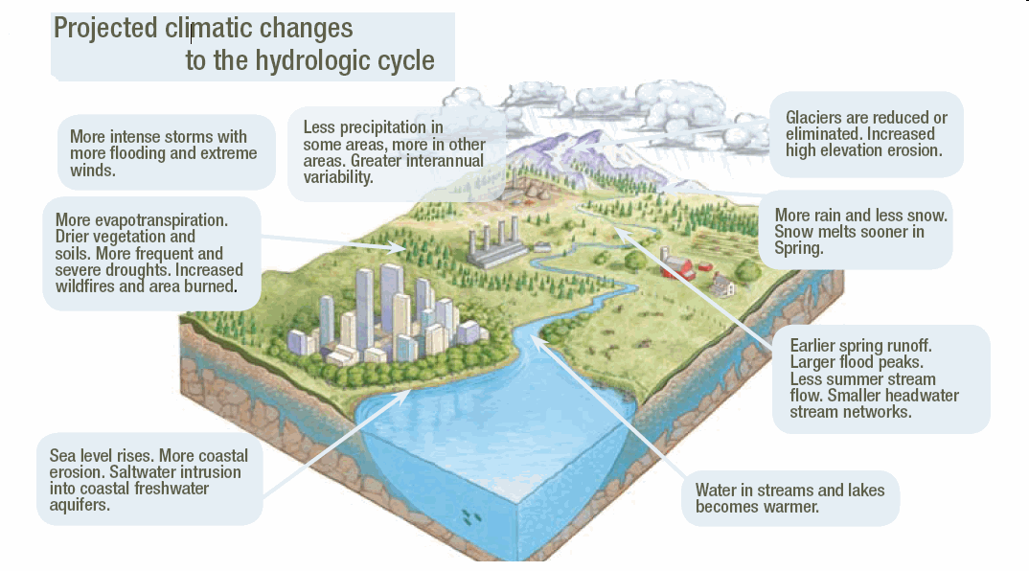
Climate Change = Hydrologic Change

Slide 9
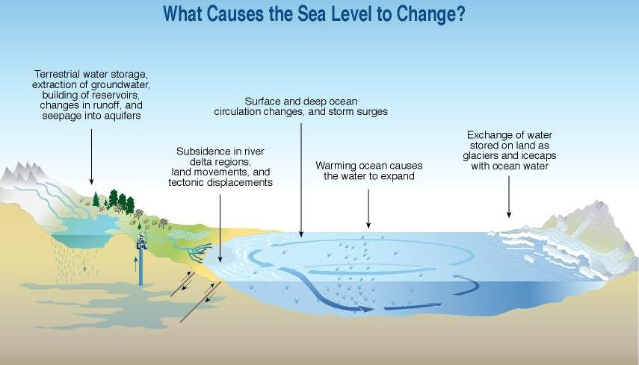
Sea Level Rise

Slide 10
Climate Change and Water
Future effect of climate change on global water resources depends on both
  Climatic factors AND
  Non-climatic factors
    Population growth
    Changes in economy
    Development of new tech
    Changes in watershed characteristics
    Watershed management

Slide 11
Impacts of Climate Change
Changes in Water Availability
  Quantity
  Quality
  Timing
  Distribution

Slide 12
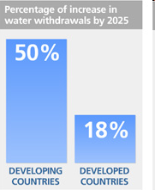
Is this sustainable?
Limited fresh water resources
Uneven distribution of
water resources
Water pollution
Climate change
Growing population
http://www.unwater.org/img/usepercentage.jpg

Slide 13
Understanding Significant climate Events in World

Slide 14
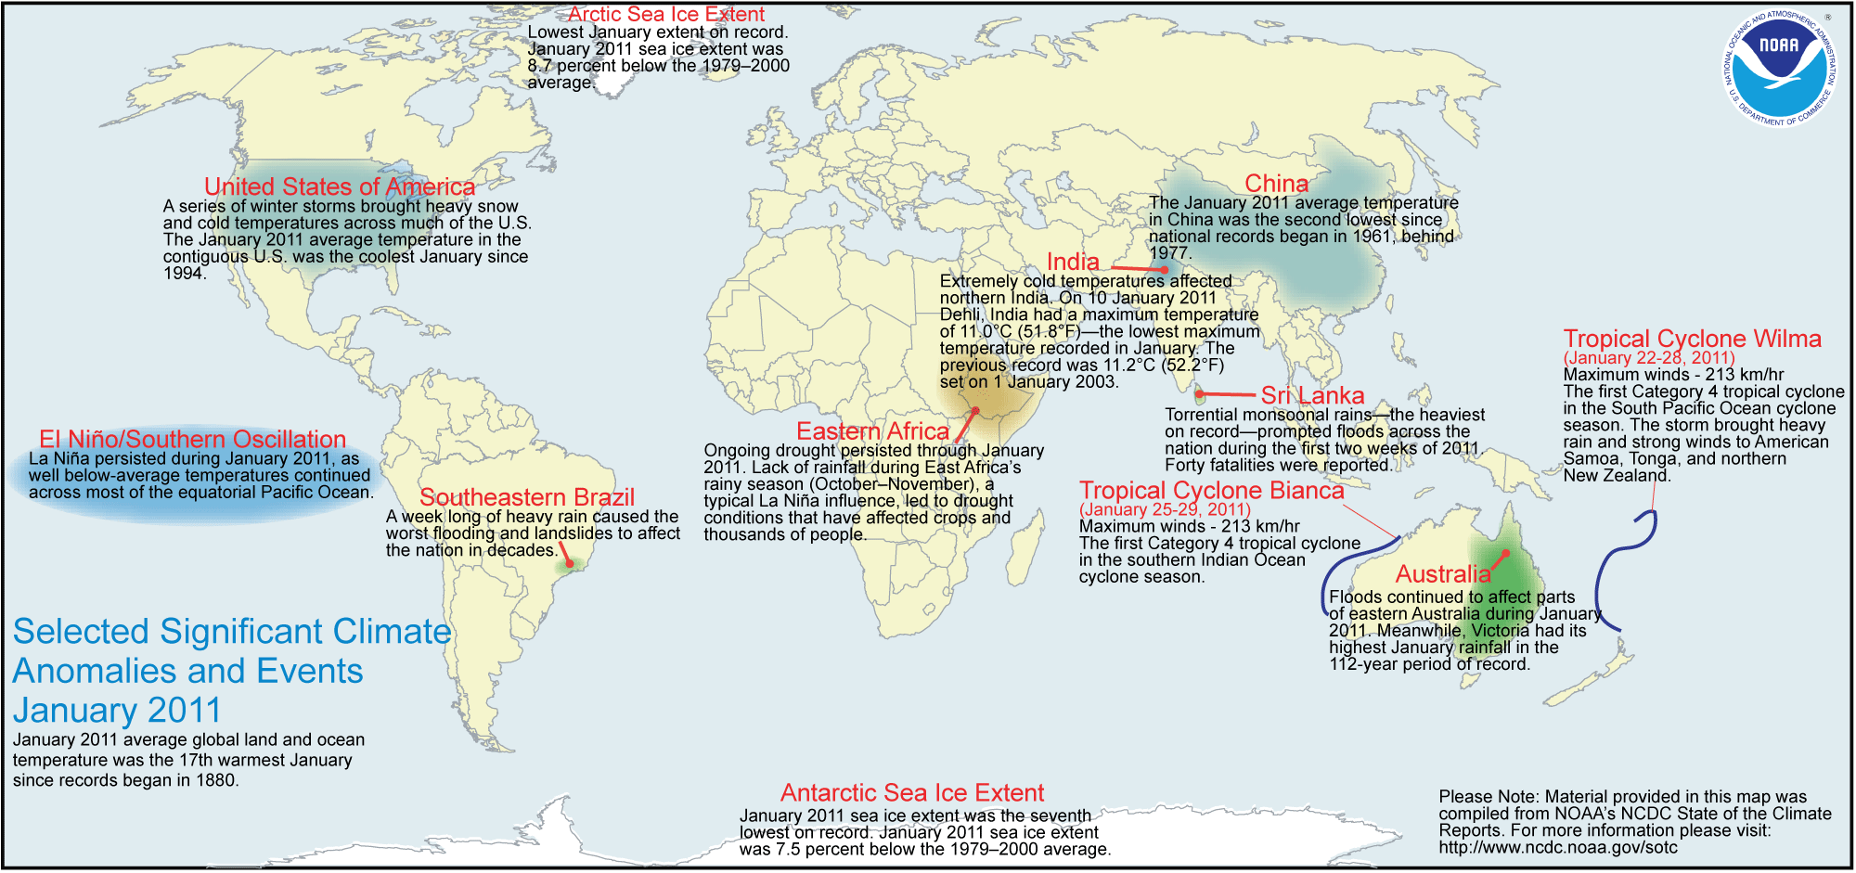
Significant Climate Events in January 2011
State of the Climate: Global Analysis
By NCDC/NESDIS/NOAA
Notes:
This slide give general idea about significant events due current climate changes.

Slide 15
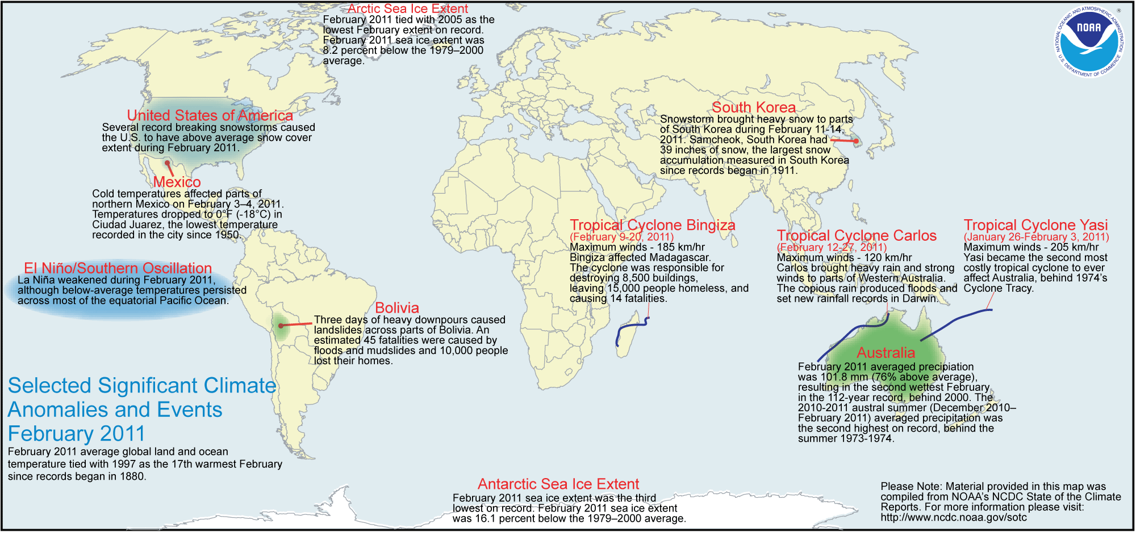
Significant Climate Events in February 2011

Slide 16
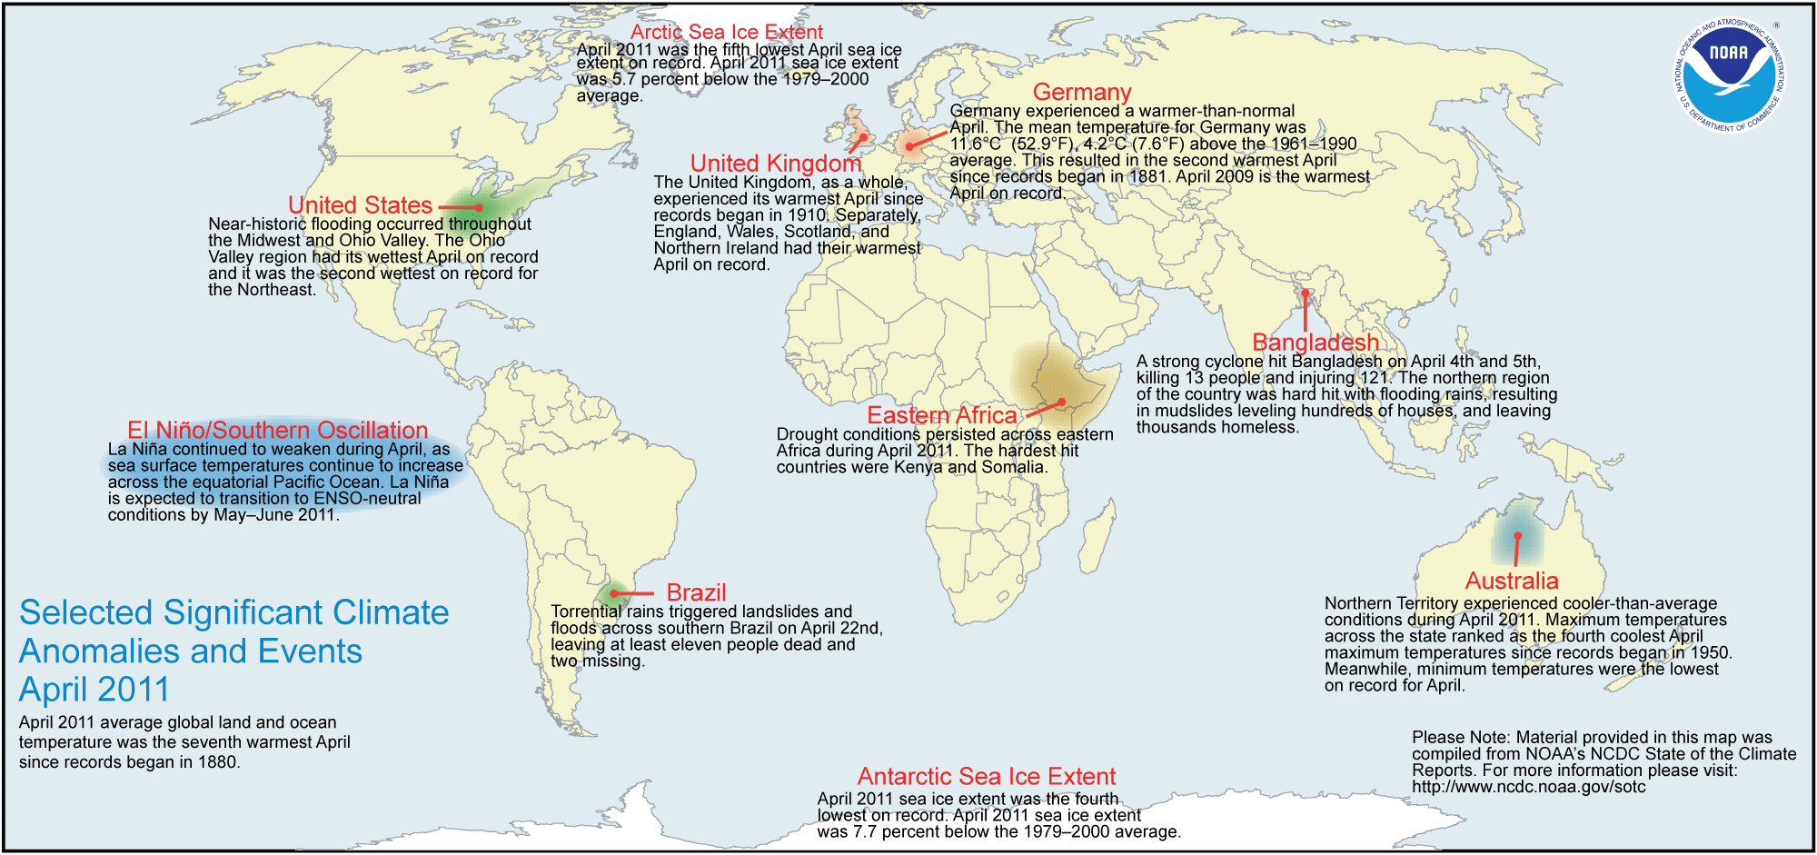
Significant Climate Events in April 2011

Slide 17
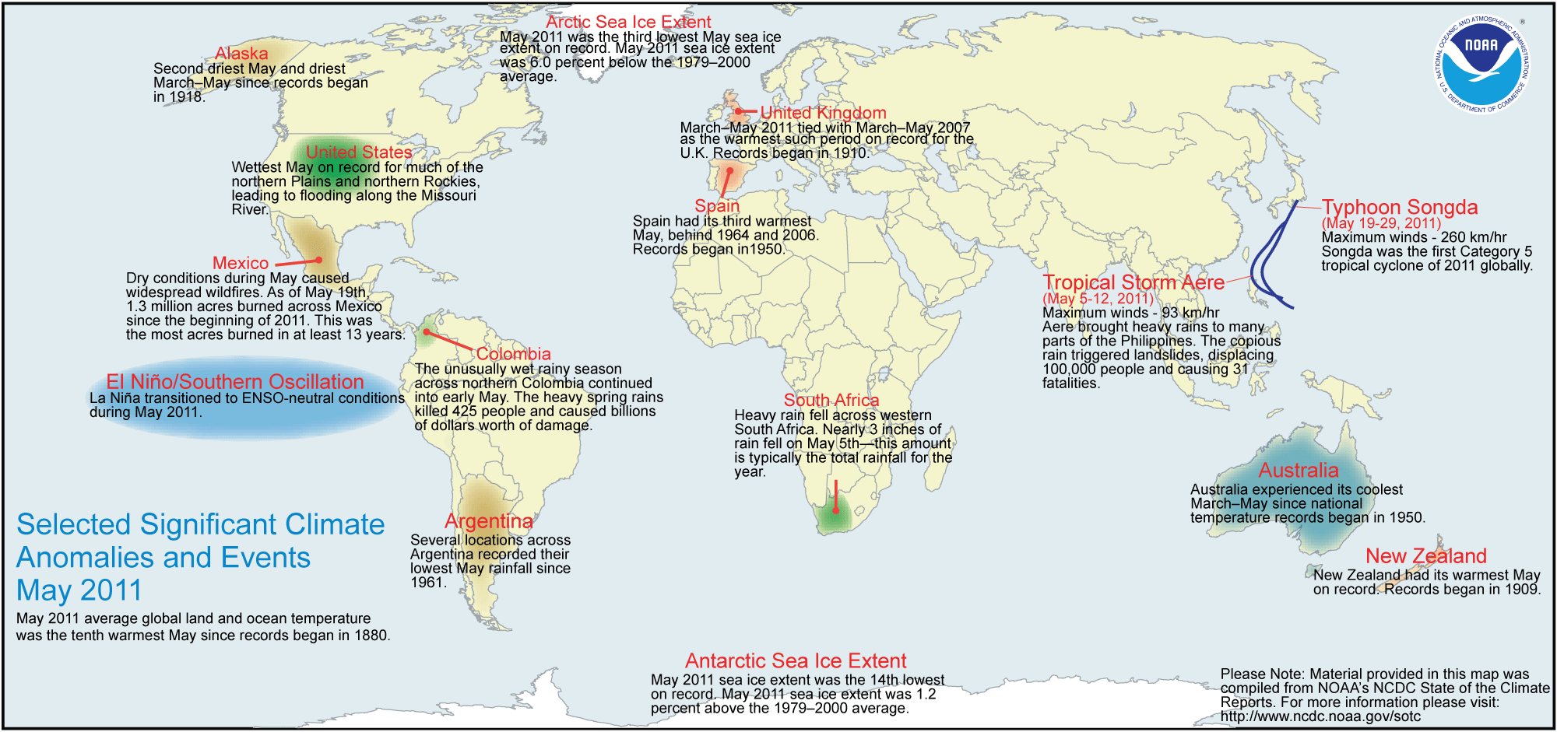
Significant Climate Events in May 2011

Slide 18
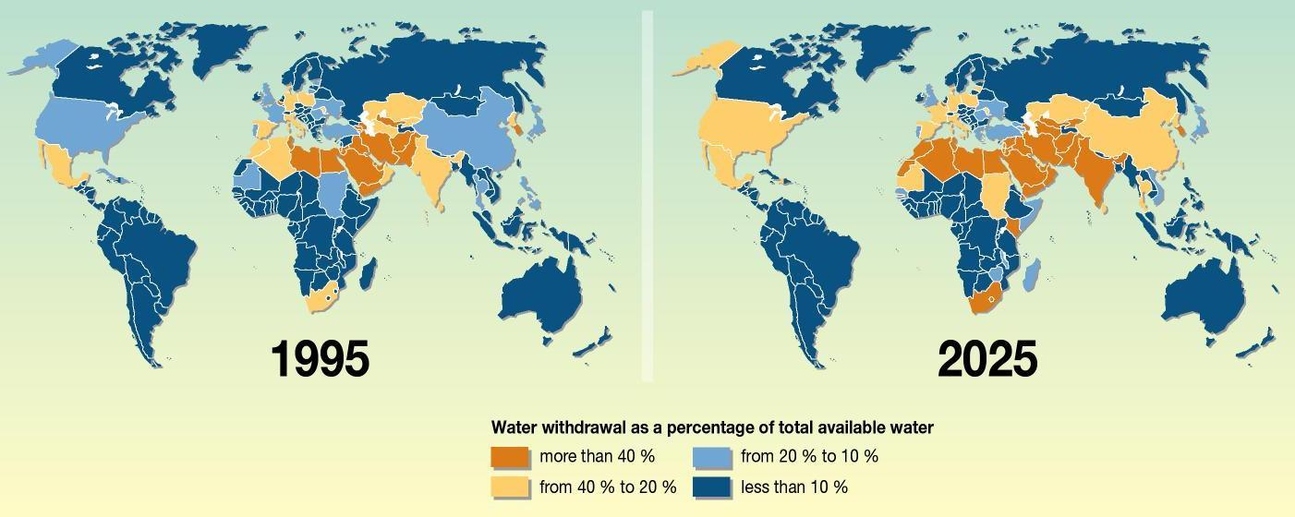
Global Water Resources
http://maps.grida.no/library/files/increased-global-water-stress_003.jpg

Slide 19
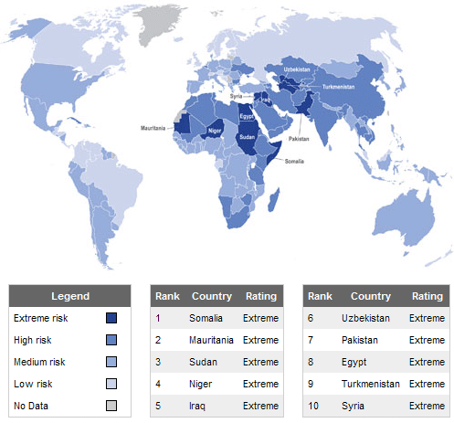
Water Security Risk Index 2010

Slide 20
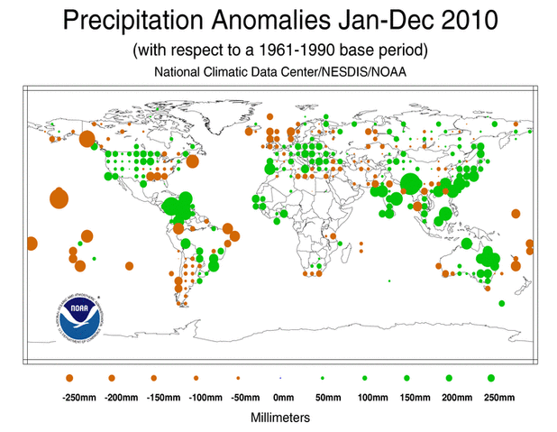
Global Precipitation Anomalies

Slide 21
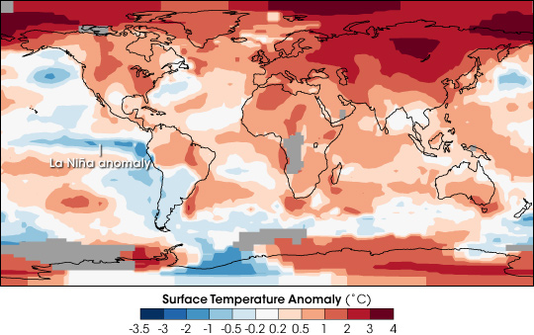
Global Temperature Anomalies
Temperature during 2007 above the 1950-1980 baseline

Slide 22
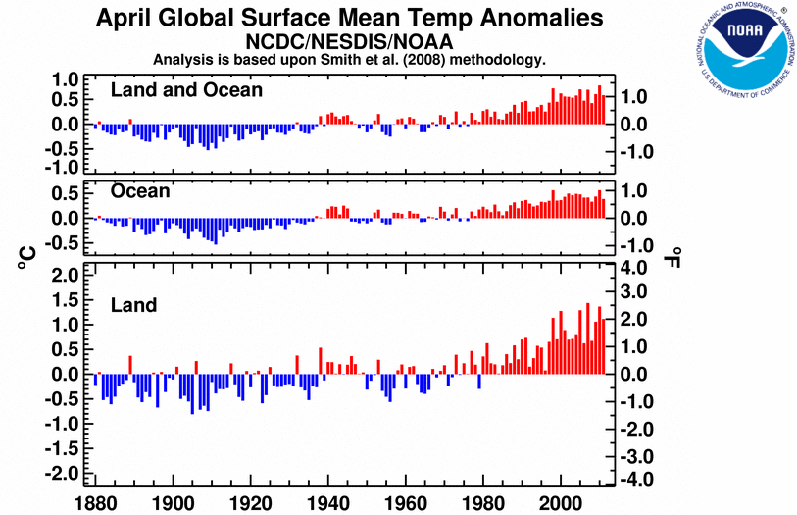
Global Temperature Anomalies
Notes:
From 1901 to 2008, each year’s temperature departure from the long-term average is one bar, with blue bars representing years cooler than the long-term average and red bars representing years warmer than that average. National temperatures vary much more than global temperatures, in part because of the moderating influence of the oceans on global temperatures.

Slide 23
A future of water wars?
“The wars of the 21st century will be fought over water.”
— Ismail Serageldin, Chairman of the World Water Commission
Already, scarcity has caused or exacerbated conflict in arid areas (e.g., Colorado River states in southwest U.S., the Middle East).
Many nations have cooperated with neighbors to resolve water disputes.

Slide 24
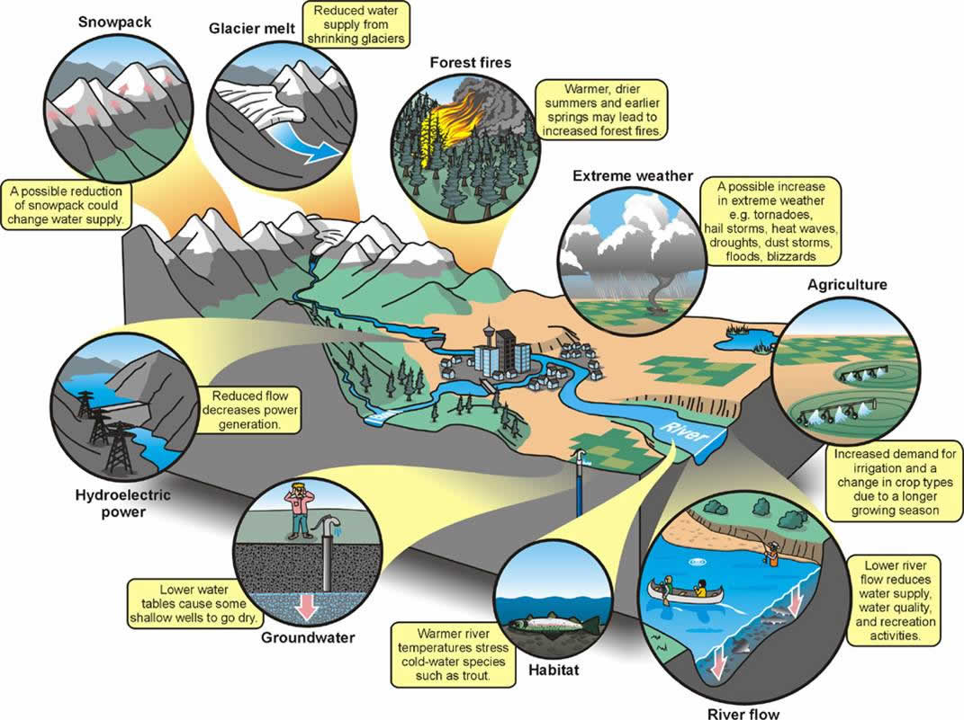
Climate Change and Water Resources

Slide 25
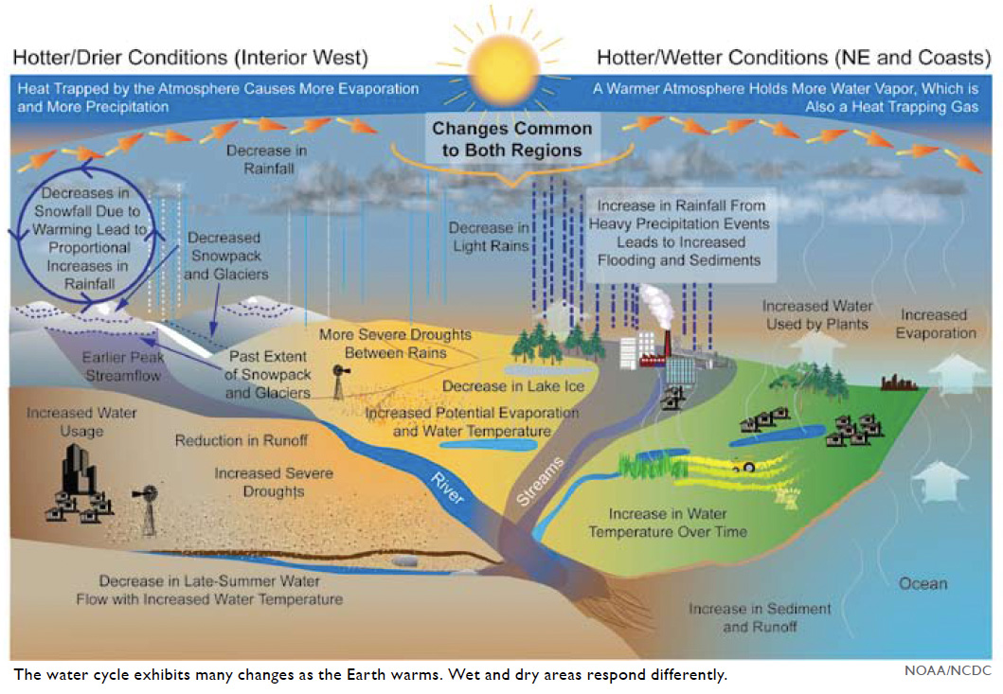
Anticipated changes in the water cycle of the United States.

Slide 26
Highlights of Water-related Impacts by Sector
Sector | Examples of Impacts
Human Health | Heavy downpours increase incidence of waterborne disease and floods, resulting in potential hazards to human life and health.
Energy Supply and Use | Hydropower production is reduced due to low flows in some regions. Power generation is reduced in fossil fuel and nuclear plants due to increased water temperatures and reduced cooling water availability.
Transportation | Floods and droughts disrupt transportation. Heavy downpours affect harbor infrastructure and inland waterways. Declining Great Lakes levels reduce freight capacity.
Agriculture and Forests | Intense precipitation can delay spring planting and damage crops. Earlier spring snowmelt leads to increased number of forest fires. High temperatures and flooding decrease food production.
Ecosystems | Coldwater fish threatened by rising water temperatures. Some warm-water fish will expand ranges.

Slide 27
Highlights of Water-related Impacts by Sector
Recreational Activity | Potential Impacts of Climate Change | Estimated Economic Impacts
Skiing, Northeast | 20% reduction in length of ski season | $800 million loss per year, potential resort closures
Snowmobiling, Northeast | Reduction of season length under higher emissions scenario | Complete loss of opportunities in New York and Pennsylvania within a few decades, 80% reduction in season length for region by end of century
Beaches, North Carolina | Many beaches are eroded, and some lost by 2080 | Reduced opportunities for beach and fishing grips, without additional cost for adaptation measures

Slide 28
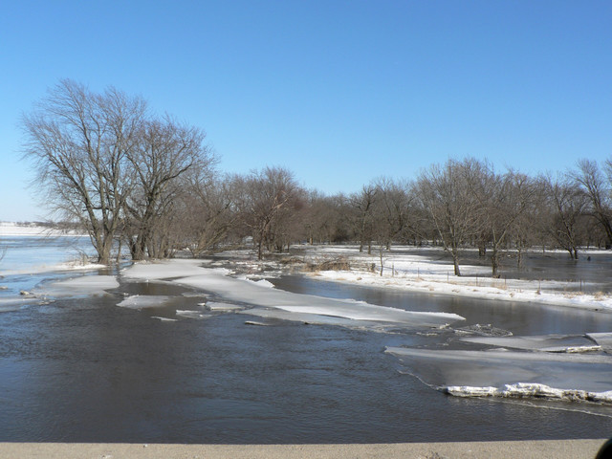
Climate impact on
Snow cover/snow melt

Slide 29
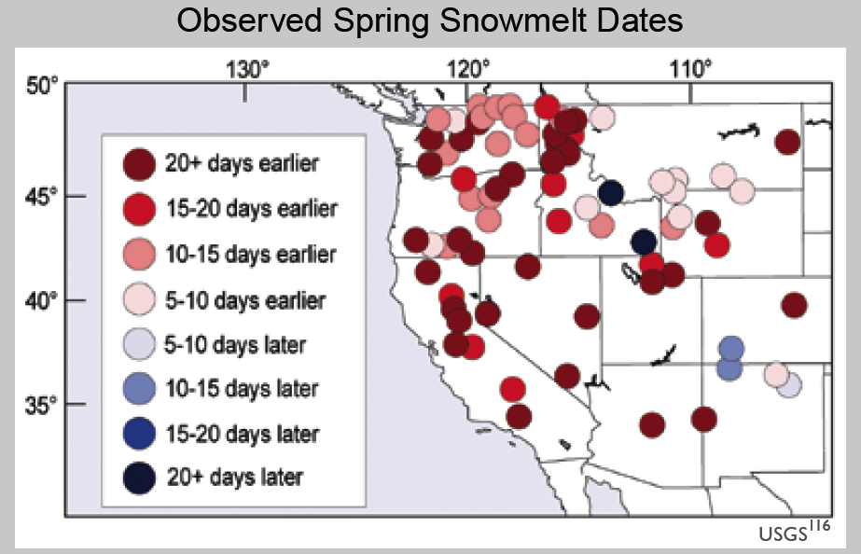
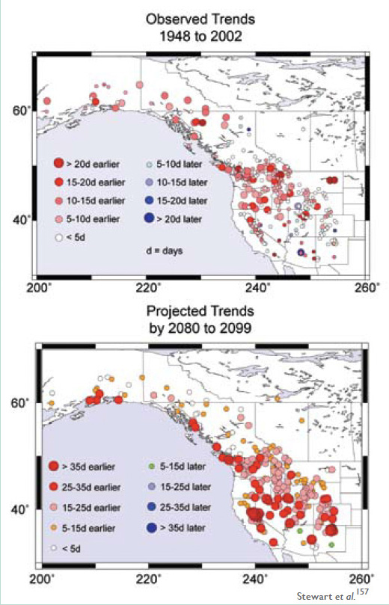
Impact of Snow Melt on in Peak Stream flow Timing
Climate change lead to larger changes in snowmelt will possibly increasing wildfire risk and creating new water management challenges for agriculture, ecosystems and urban populations.
Peak Stream flow Timing
Floods in river basins often occurs due to rapid snow melt (sometimes with ice jam) in spring
  Extreme rain on snow events in the melting season (super flash flood)

Slide 30
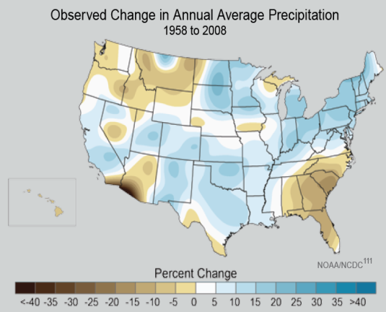

Slide 31
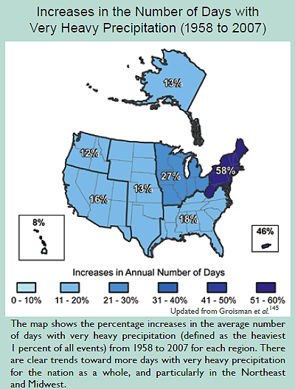
Extreme Precipitation Events
NORTHEAST:
  Average annual temperature increase of 2ºF since 1970
  Increase in warm days, longer growing season, downpours
  Decrease in precipitation falling as snow
SOUTHEAST:
  Average annual temperature increase of 2ºF since 1970
  Seasonal changes in precipitation (e.g., 30% increase in Fall, decrease in summer)
  Increase in heavy downpours and drought coverage
  Increase in power of Atlantic hurricanes since 1970

Slide 32
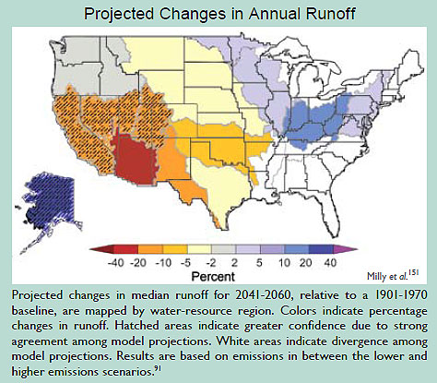
Change in Annual Runoff

Slide 33
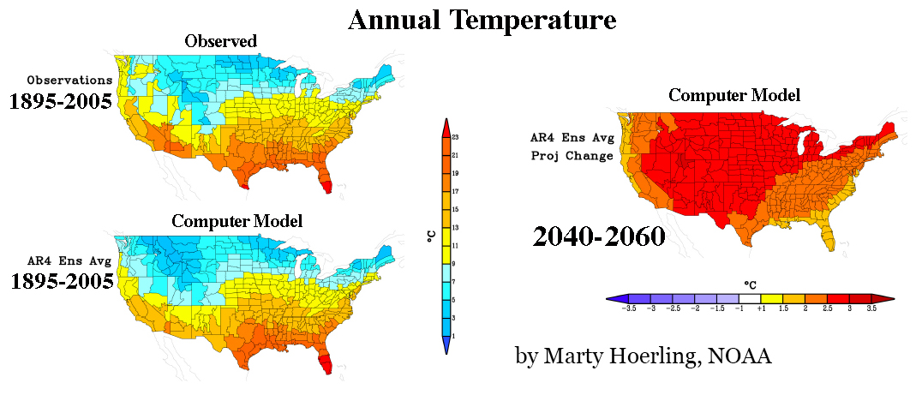
Projected U.S. Temperature Increase (2040-2060)
Notes:
The map on the right shows the projected increase in the annual temperature for the period 2040 to 2060. On the left is the observed increase between 1895 and 2005 (top) and the computer model for the same period. The similarity between the observed and computer model strengthen the results of the same computer model results shown on the right. However, the computer model does not take into account possible increasing positive feedbacks, discussed later, that could result in higher temperatures.

Slide 34
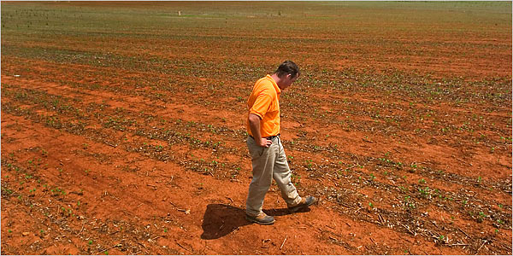
Effect on Soil Moisture:
Droughts

Slide 35
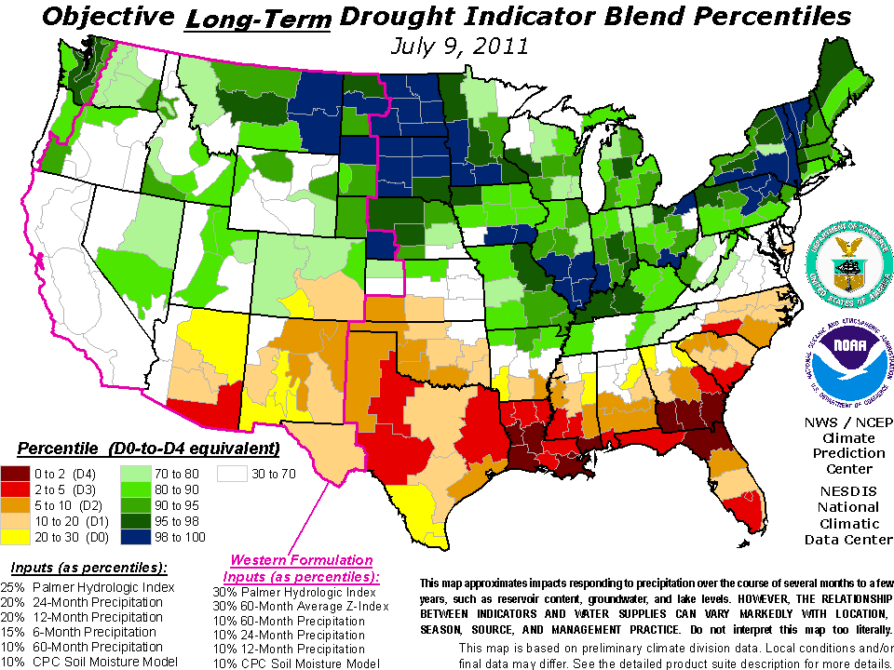
Long Term Drought Conditions

Slide 36
Effect on Agriculture Productivity
An increase in average temperature can
  lengthen the growing season in regions with a relatively cool spring and fall;
  adversely affect crops in regions where summer heat already limits production;
  increase soil evaporation rates, and
  increase the chances of severe droughts.
Changes in rainfall can affect soil erosion rates and soil moisture, both of which are important for crop yields.
Food production is projected to benefit from a warmer climate, but there probably will be strong regional effects, with some areas in North America suffering significant loss of comparative advantage to other regions.
The U.S. Great Plains/Canadian Prairies are expected to be particularly vulnerable.

Slide 37
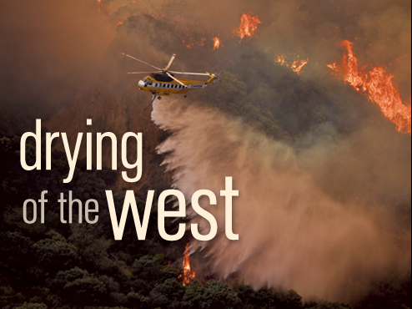
Effect on Forest Fire

Slide 38
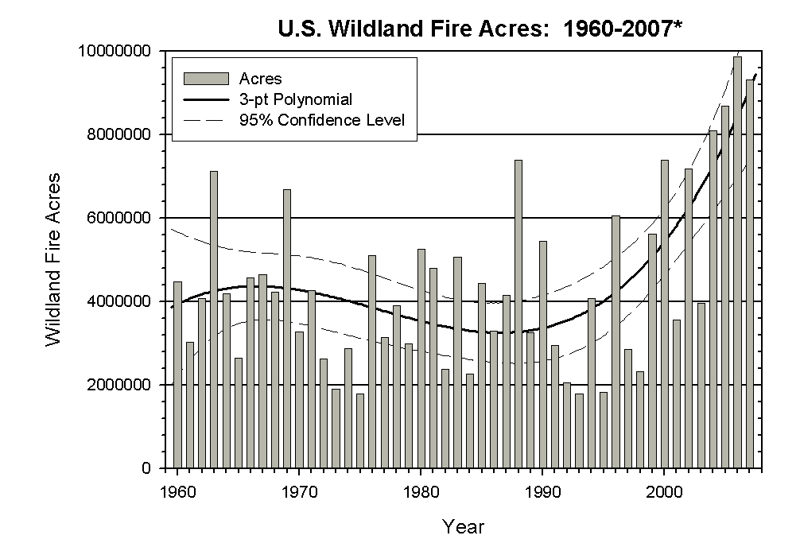
Forest Fire
Large forest fires have occurred more frequently in the western United States since the mid-1980s as spring temperatures increased, mountain snows melted earlier and summers got hotter.

Slide 39
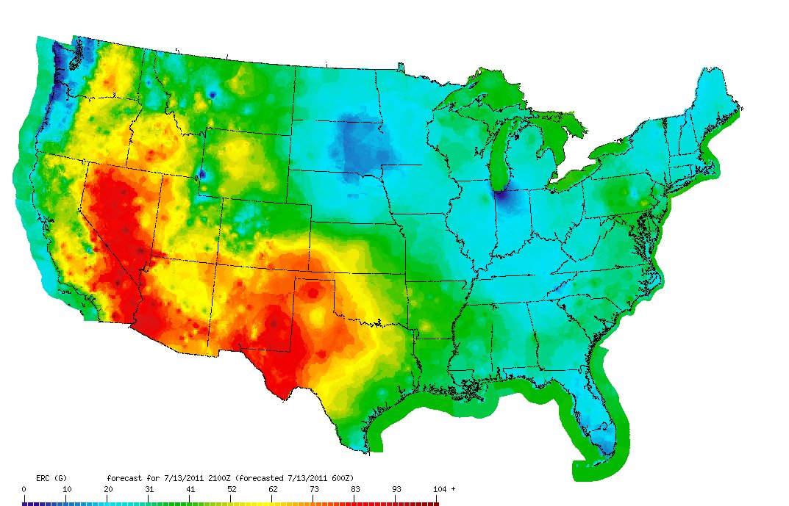
Fire danger forecasts
These forecasts can be used for operational and strategic fire planning at regional and national scales.
Source: Wild land Fire Assessment System / National Weather Service

Slide 40
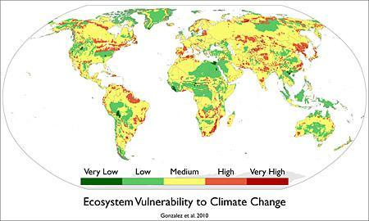
Climate Change Link with Vegetation Shifts
ScienceDaily (June 9, 2010)
The long-term vegetation shifts in which climate plays more role than impacts from local human activity such as deforestation.
Some examples of biome shifts that occurred include woodlands giving way to grasslands in the African Sahel, and shrublands encroaching onto tundra in the Arctic.
Vegetation has been gradually moving toward the poles and up mountain slopes, where temperatures are cooler, as well as toward the equator, where rainfall is greater.

Slide 41
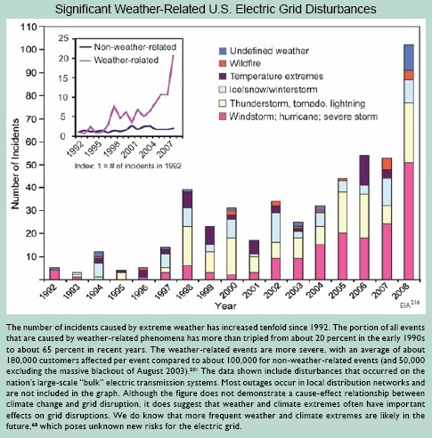
Other Effects of Climate Change

Slide 42
Observed Water-Related Changes During the Last Century
Observed Change | Direction of Change | Region Affected
One to four week earlier peak streamflow due to earlier warming-driven snowmelt | Earlier | West and Northeast
Proportion of precipitation falling as snow | Decreasing | West and Northeast
Duration and extent of snow cover | Decreasing | Most of the U. S.
Mountain snow water equivalent | Decreasing | West
Annual precipitation | Increasing | Most of the U. S.
Annual precipitation | Decreasing | Southwest
Frequency of heavy precipitation events | Increasing | Most of the U. S.
Runoff and streamflow | Decreasing | Colorado and Columbia River Basins
Streamflow | Increasing | Most of East
Amount of ice in mountain glaciers | Decreasing | Western mountains and Alaska
Water temperature of lakes and streams | Increasing | Most of the U. S.
Ice cover on lakes and rivers | Decreasing | Great Lakes and Northeast
Periods of drought | Increasing | Parts of West and East
Salinization of surface waters | Increasing | Florida and Louisiana
Widespread thawing of permafrost | Increasing | Alaska

Slide 43
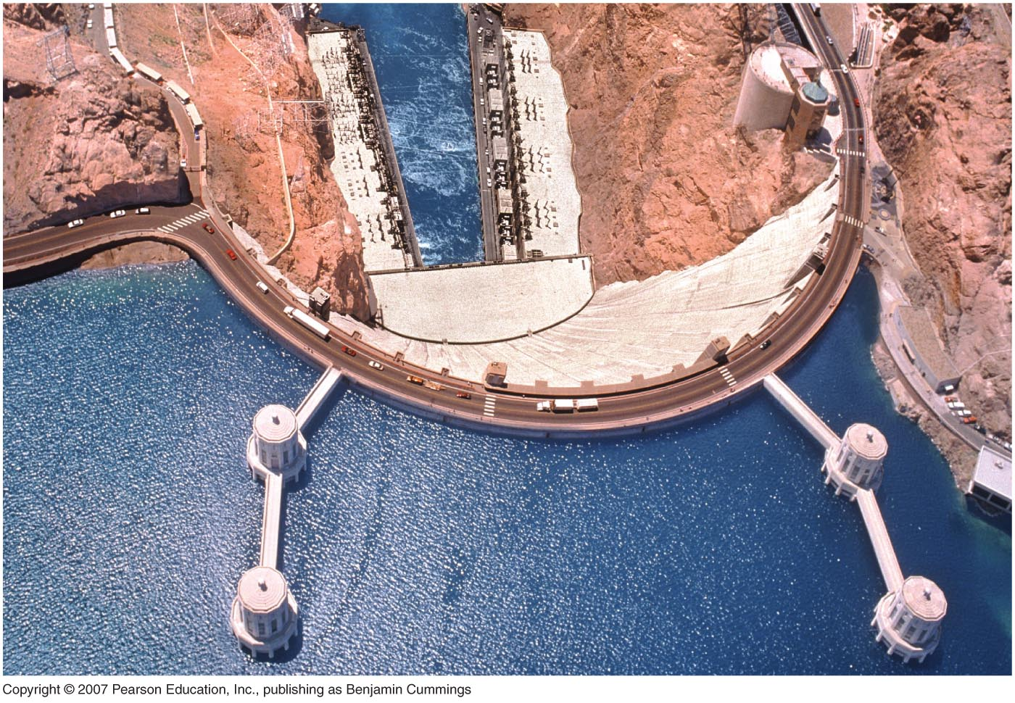
Plumbing the Colorado River
The once-mighty Colorado River is now dammed. So much water is withdrawn that it barely reaches the sea.
Western states apportion the water according to a pact, but California has long exceeded its share.
In 2003 the U.S. government cut California’s flow. Months of wrangling followed until a deal was reached.

Slide 44
Climate Change and Water in California

Slide 45
Climate Change Impacts to California’s Water Resources
By 2050: loss of at least 25 percent of the Sierra snowpack
More variable weather patterns
  More flooding and longer, more severe droughts
Rising water temperatures and changes in runoff patterns
may adversely impact salmon and other species.
Sea level rise will threaten many coastal communities as well as the sustainability of the Sacramento-San Joaquin Delta.
  Salt water intrusion
http://www.water.ca.gov/climatechange/docs/062807factsheet.pdf

Slide 46
http://www.water.ca.gov/climatechange/docs/062807factsheet.pdf

Slide 47
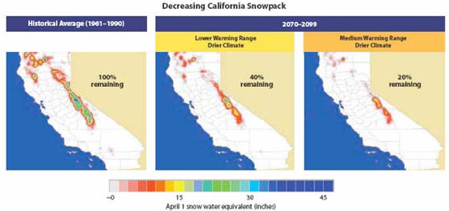
Snowpack Projections
Ten-year moving average percent change in April 1 snowpack simulated. Region labels are as follows, PNW – Pacific Northwest, CRM - Central Rocky Mountains, SN -Sierra Nevada, and SRM - Southern Rocky Mountains.

Slide 48
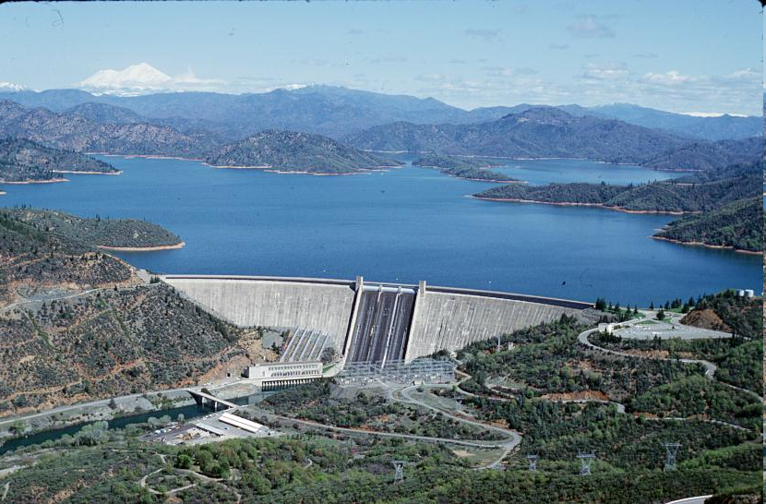
Potential reduction in hydropower
  Increased population and greater demand for energy
  Decreased snow melt flowing through = decreased potential for hydropower production
  However, future precipitation projections are uncertain.
Shasta dam
(USGS)
http://www.climatechoices.org/ca/site/ca/site/our-changing-climate.html

Slide 49
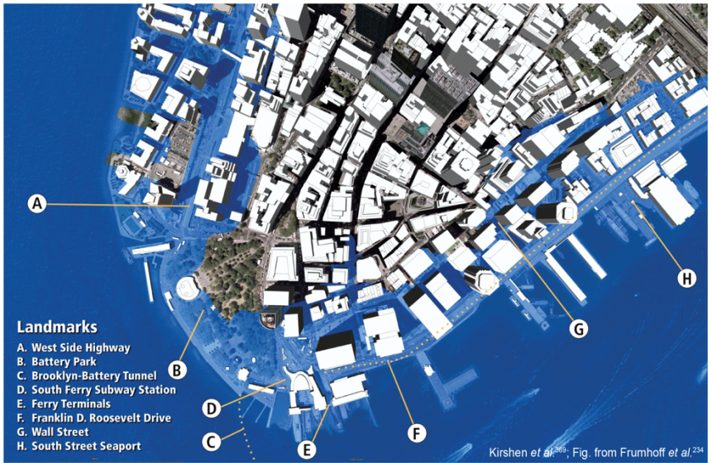
Coastal inundation impact…New York

Slide 50
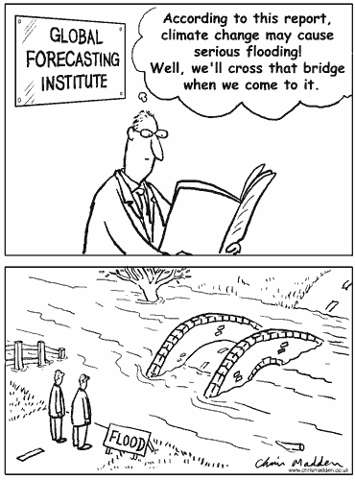
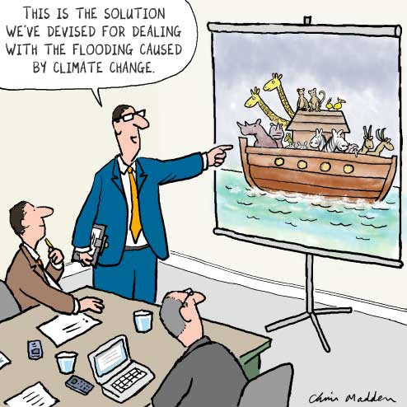
Questions?

